Slide 1
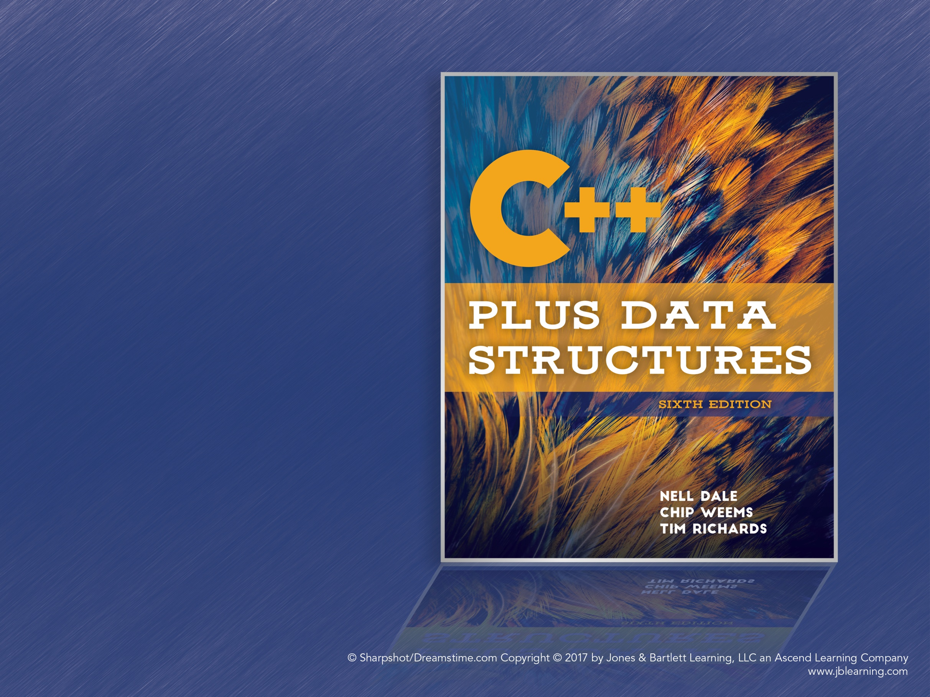
Chapter 1
Software Engineering
Principles

Slide 2
The Software Process
How do we write complex programs?
Focus on the software life cycle
Develop techniques of software engineering

Slide 3
Software Engineering
A disciplined approach to the design, production, and maintenance of computer programs
Use tools that help manage the size and complexity of the resulting software
Ensure that projects are developed on time and within cost estimates

Slide 4
The Software Life Cycle
Problem analysis
Requirements elicitation
High- and low-level design
Implementation of the design
Testing and verification
Delivery
Operation
Maintenance

Slide 5
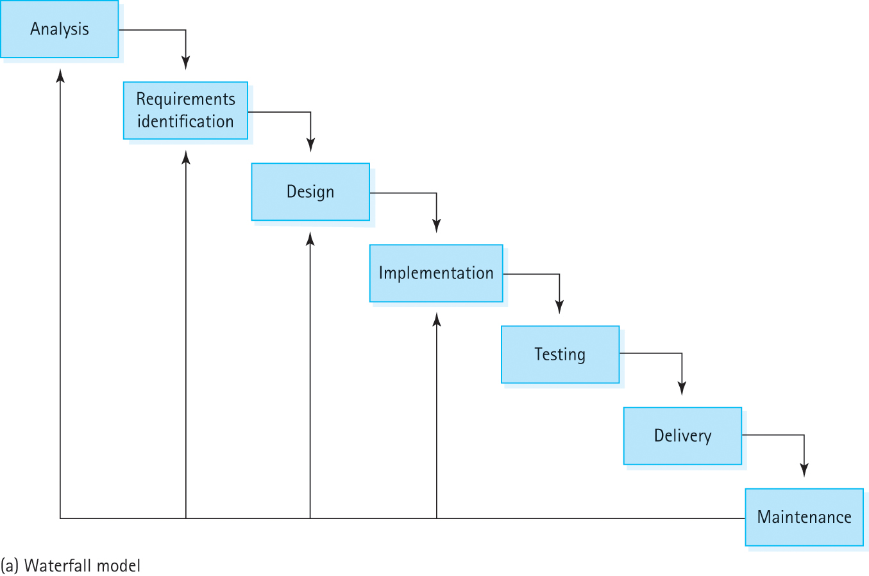
Waterfall Model
Figure 1.1a Life-cycle models: (a) Waterfall model (b) Spiral model

Slide 6
An Algorithm Is…
A logical sequence of discrete steps that describes a complete solution to a problem, computable in a finite amount of time.

Slide 7
Goals of Quality Software
It works
It can be modified without excessive time and effort
It is reusable
It is completed on time and within budget

Slide 8
Quality Software Works
Requirements: Describe what service the software should provide
Software Specification: A written document that tells what a program does but not how
Quality software must be complete and correct, and do everything as explained in the specification

Slide 9
Software Specifications
The specification describes what services a program should provide, based on the users’ requirements
Scenario: Sequence of events describing one complete execution of the program
Useful questions:
  What is the expected input and output?
  How will errors be handled?
  How will the program be used?

Slide 10
Program Design
A program’s specification describes what a program does, not how it does it
Design Phase: Evaluating how a program will accomplish its specified tasks
Many useful ideaware tools can help

Slide 11
Abstraction
A model of a complex system that includes only the essential details
Programs are abstractions
Simplify work by hiding complex details

Slide 12
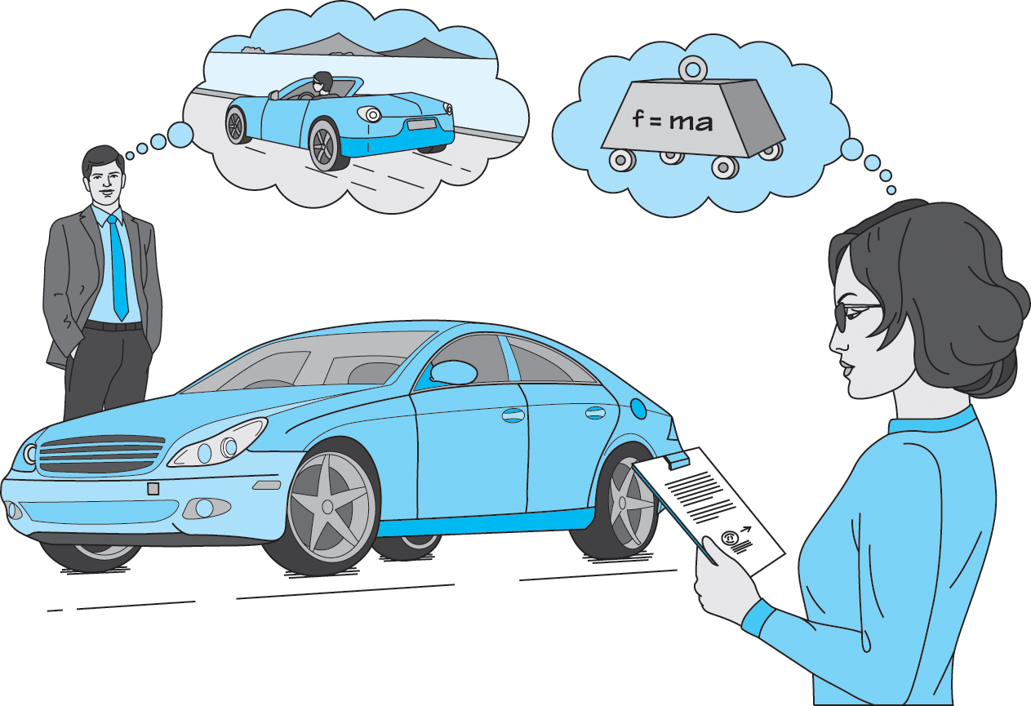
Abstraction (cont.)
Figure 1.2 An abstraction includes the essential details relative to the perspective
of the viewer

Slide 13
Information Hiding
The practice of hiding the details of a module with the goal of controlling access to the details of a module
Module: A cohesive system subunit that performs some share of the work
Information hiding allows programmers to focus on one module at a time
Each module should serve a single purpose

Slide 14
Stepwise Refinement
Approaching a problem in stages, step by step
Top-down: Break problem into pieces, deferring details as long as possible
Bottom-up: Focus on details first and build up to the high-level components
Functional Decomposition: Approach a program as a set of cooperating functions
Round-trip Gestalt: Top-down with emphasis on objects and data

Slide 15
Visual Tools
Abstraction, information hiding, and stepwise refinement help manage complexity
Visual Tools: Help us visualize the design
UML Diagrams: Define components and the relationships between them
CRC Cards: Describe classes, their responsibilities, and their collaborators

Slide 16
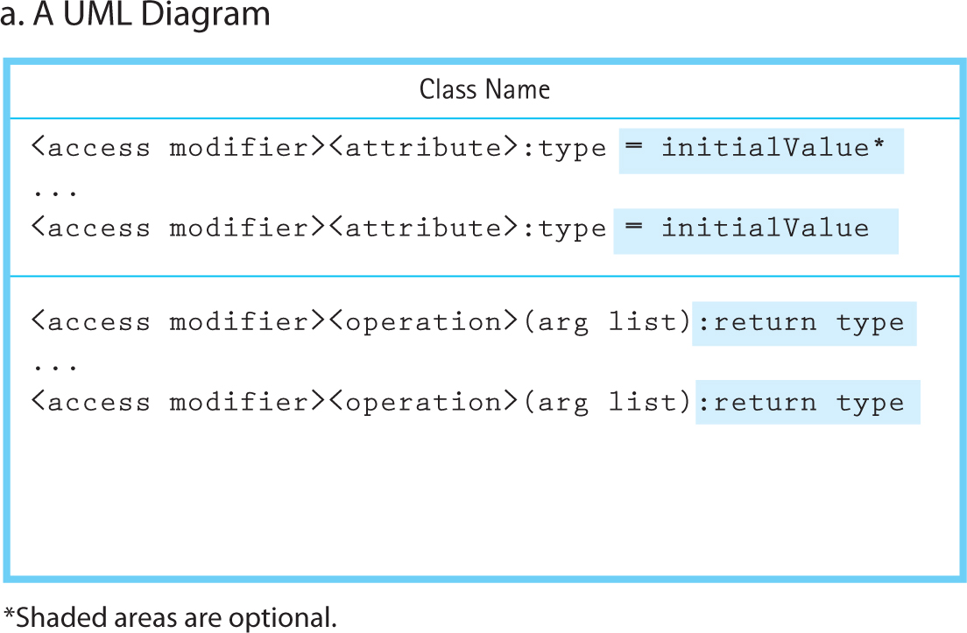
UML Diagrams
Figure 1.3a UML Class Diagram and CRC Card: (a) A UML Diagram (b) A CRC Card

Slide 17
Top-Down Design
Starts with a “big-picture” view of the program
Then, break the picture down into tasks
Continue breaking down the tasks until they can be easily described in code
Functional decomposition breaks the program into functions that form a complete solution to the problem when used together

Slide 18
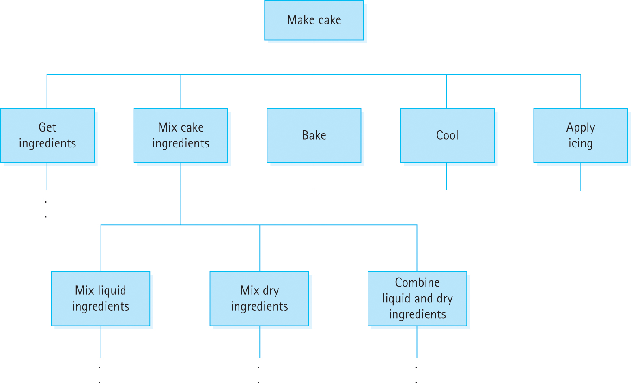
Top-Down Design: Cake
Figure 1.4 A portion of a functional design for baking a cake

Slide 19
Objected-Oriented Design
Divide-and-conquer, but break down the program into things instead of tasks
The design consists of objects, which are defined by classes
Objects combine data and operations

Slide 20
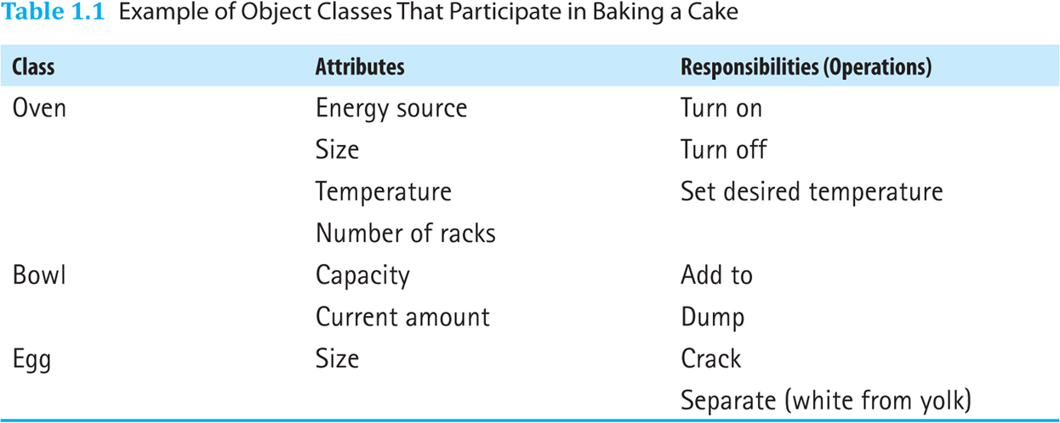
Classes for Baking a Cake
Table 1.1 Example of Object Classes That Participate in Baking a Cake

Slide 21
Procedural vs. Object Oriented
“Read the specification of the software you want to build. Underline the verbs if you are after procedural code, the nouns if you aim for an object-oriented program.”
Grady Booch, “What Is and Isn’t Object Oriented Design,” 1989.

Slide 22
Verification of Software Correctness
Testing: Executing a program with input designed to find errors
Debugging: Investigating and removing known errors from a program
Acceptance Test: Testing in a real environment with real data
Regression Test: Testing that a program is still correct after being modified

Slide 23
Verification and Validation
Is testing enough?
Program Verification: Checking that a program fulfills its specification
  “Are we doing the job right?”
Program Validation: Checking that the program fulfills its intended purpose
  “Are we doing the right job?”

Slide 24
Compile-Time Errors
It’s not impossible to write clean, syntactically correct code on the first try
These errors are generally easier to handle than other types of errors
Knowing your tools (programming language, editor, etc.) will help avoid these errors

Slide 25
Run-Time Errors
An error that occurs during execution, often causing the program to crash
Robustness: The ability of a program to recover from an error
Run-time errors can often be found with sufficient testing
Errors should be handled gracefully instead of allowing the program to crash

Slide 26
Designing for Correctness
We would like to prove a program is correct
Make assertions (logical propositions) about what a program should do
Then, prove the design fulfills the assertions

Slide 27
Conditions on Functions
Assertions can be applied at the module level
Precondition: A condition that must be true before an operation is executed
Postcondition: A condition that will be true after an operation completes
The postcondition will be true if the precondition is true

Slide 28
Design Review Activities
Deskchecking: Tracing an execution of a design or program on paper
Walk-through: A team performs a manual simulation of the program or design
Inspection: One member of a team reads the program or design line by line while others point out the errors

Slide 29
Exceptions
Exceptions allow programs to interrupt normal control flow to handle exceptional situations
Handling them should be part of the design
Different languages have different facilities for handling exceptions

Slide 30
Program Testing
Testing is used to find remaining errors
Test Case: A single test used to check a particular program feature. For each case:
  Determine inputs
  Determine the expected behavior of the program
  Run the program and observe its behavior
  Compare the expected behavior and the actual behavior

Slide 31
Streaming Input and Output
C++ uses streams to handle input and output
The <iostream> header file defines:
  “cin” (standard input stream) (the keyboard)
  “cout” (standard output stream) (the screen)
  “cerr” (standard error output stream) (the screen)
Streams use the “<<” and “>>” operators

Slide 32
Insertion Operator (<<)
The insertion operator (<<) takes 2 operands
The left operand is the stream to operate on, such as cout
The right operand describes what will be inserted into the stream

Slide 33
Extraction Operator
The extraction operator (>>) takes 2 operands
The left operand is a stream to operate on, such as cin
The right operand is a variable that will be given a value from the stream
The operator attempts to extract the next item from the input stream and store its value in the variable

Slide 34
File I/O
File I/O is defined in the <fstream> header
It uses streams just like <iostream>
Defines input (ifstream) and output (ofstream) file objects
Make sure to close the file when finished!

Slide 35
Stream Failure
When a stream enters the fail state, further I/O operations using that stream are ignored
The program does not crash and there is no error message
Possible reasons for entering the fail state are:
  Invalid input data (often using the wrong type)
  Opening an input file that doesn’t exist
  Opening an output file that is write-protected

